Slide 1
Predicting Hotel Booking Cancellations Using Machine Learning
A data analytics and machine learning approach to improve hotel revenue planning and operational efficiency
Presented by: Jenefa Ukpong
10Alytics Capstone Project
Project focus
Understand cancellation behavior and identify high-risk bookings before revenue is lost.
Notes:
Good day everyone. My project focuses on predicting hotel booking cancellations using machine learning. The aim is to help the hotel understand why customers cancel bookings and how data can be used to reduce revenue loss, improve planning, and support better business decisions.

Slide 2
Business Problem
Revenue uncertainty from cancelled reservations
Poor occupancy forecasting
Inefficient staffing and room allocation
Lost sales opportunities when rooms are not resold
Difficulty planning daily hotel operations
Business need
The hotel needs a data-driven way to identify bookings that are likely to be cancelled before they happen.
Why it matters
Early cancellation prediction supports better pricing, staffing, inventory planning, and customer follow-up.
Hotel Booking Cancellation Prediction
02
Notes:
Booking cancellations can seriously affect hotel performance. When guests cancel, the hotel may lose expected revenue, rooms may remain empty, and management may struggle to plan staffing, inventory, and daily operations. This project addresses that problem by using data to identify patterns linked to cancellations.

Slide 3
Project Objectives
Explore
Identify
Prepare
Analyze hotel booking data and understand customer behaviour.
Find the key factors influencing booking cancellations.
Clean, transform, engineer, encode, and scale useful features.
Predict
Recommend
Build classification models to predict booking status.
Turn the analysis into actions that reduce cancellations and protect revenue.
Hotel Booking Cancellation Prediction
03
Notes:
The project combines business analysis and machine learning. First, I explored the dataset to understand booking behavior. Then I cleaned and prepared the data, developed machine learning models, evaluated their performance, and used the findings to make recommendations that can help the hotel reduce cancellations.

Slide 4
Dataset Overview
36,285
17
1
Target variable: booking status
booking records
original variables
target variable
Shows whether a booking was cancelled or not cancelled.
Key variables in the dataset
Lead time, average price, and special requests
Room type, meal type, and market segment
Number of adults, children, weekend nights, and week nights
Date of reservation and previous booking history
Hotel Booking Cancellation Prediction
04
Notes:
The dataset includes information about customer bookings, such as how many adults and children were included, the room type selected, meal plan, lead time, average price, market segment, and whether the booking was cancelled or not. The target variable for this project is booking status.

Slide 5
Data Cleaning
Checked for missing values across all columns
Checked for duplicate records
Converted reservation date to datetime format
Removed invalid date records after conversion
Confirmed the dataset was ready for analysis and modelling
Quality check result
No duplicate records were found in the dataset. The original data also showed no missing values before date conversion.
Data reliability
Cleaning ensured the analysis was based on valid records and correctly formatted date features.
Hotel Booking Cancellation Prediction
05
Notes:
Before analysis, I checked the quality of the dataset. The original dataset had no missing values and no duplicate records. The date of reservation column was converted into a proper datetime format, and invalid date entries identified during conversion were removed. This helped ensure the data was reliable for analysis and modelling.

Slide 6
Feature Engineering
New features created
Machine learning preparation
Year
Month
Month name
Quarter
Lead time group
Categorical variables were encoded into numerical format
Date information was transformed into useful time-based features
Lead time was grouped to reveal booking behaviour patterns
Purpose
Feature engineering made the dataset more meaningful for both business analysis and model performance.
Hotel Booking Cancellation Prediction
06
Notes:
Feature engineering helped create more useful variables from the existing dataset. For example, the reservation date was used to extract year, month, month name, and quarter. Lead time was also grouped into categories to better understand customer booking behaviour. Since machine learning models work with numeric values, categorical columns were encoded.

Slide 7
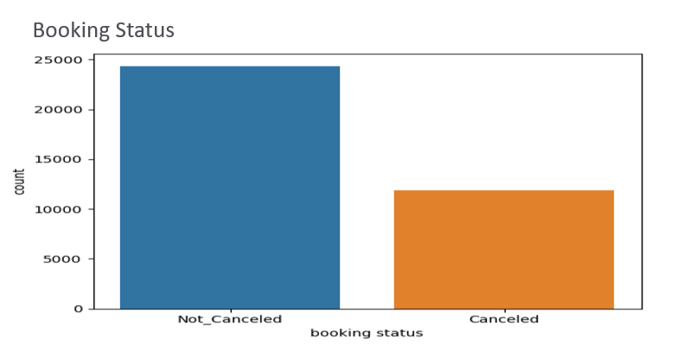
Booking Status Distribution
Visual: Booking Status
67.2%
not cancelled
32.8%
cancelled
Almost 1 in every 3 bookings did not go ahead, making cancellation prediction important for revenue and resource planning.
Hotel Booking Cancellation Prediction
07
Notes:
The target variable showed that most bookings were completed, but the cancellation rate was still high. About one-third of all bookings were cancelled. This level of cancellation can affect revenue, occupancy planning, and hotel operations, making it important to predict cancellation risk early.

Slide 8
Customer and Booking Behaviour
Most bookings were made for 2 adults
Most bookings had no children
Short stays were more common than long stays
Meal Plan 1 was the most selected meal option
Room Type 1 was the most commonly booked room
Online bookings formed the largest market segment
Core customer segment
The hotel mainly serves couples or two-adult bookings, with fewer family bookings involving children.
Channel insight
Online booking channels are important because they represent a large share of customer demand.
Hotel Booking Cancellation Prediction
08
Notes:
The exploratory analysis showed that couples or two-adult bookings formed the largest customer segment. Most customers booked without children, and short stays were more common than extended stays. The hotel also received a large number of online bookings, showing that online channels are important for customer acquisition.

Slide 9
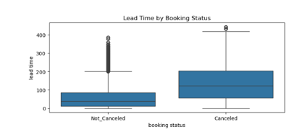
Lead Time and Cancellation Risk
Visual: Lead Time by Booking Status
Customers with longer lead times were more likely to cancel
Short lead-time bookings were more reliable
Cancellation risk increased when bookings were made far in advance
Key insight
Cancellation risk is strongly linked to when customers book, not only who they are or how much they pay.
Hotel Booking Cancellation Prediction
09
Notes:
Lead time refers to the number of days between booking and arrival. The analysis showed that customers who booked far in advance were more likely to cancel. This may be because their plans are more likely to change over time. This makes lead time one of the most important variables for predicting cancellation risk.

Slide 10
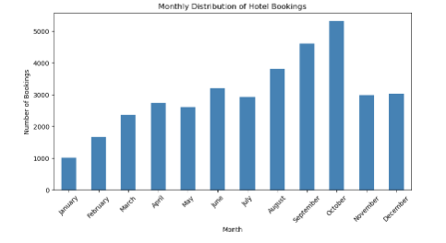
Seasonal Booking Trend
Visual: Monthly Distribution of Hotel Bookings
Bookings were lowest in January
Bookings increased steadily through the year
October had the highest booking volume
Demand was stronger between August and October
Seasonal patterns can support pricing, staffing, promotions, and room availability planning.
Hotel Booking Cancellation Prediction
10
Notes:
The monthly trend showed that hotel demand was not equal throughout the year. Bookings were weaker at the beginning of the year and stronger towards the second half, especially around August to October. This insight can help the hotel plan staff levels, promotions, room pricing, and inventory more effectively.

Slide 11
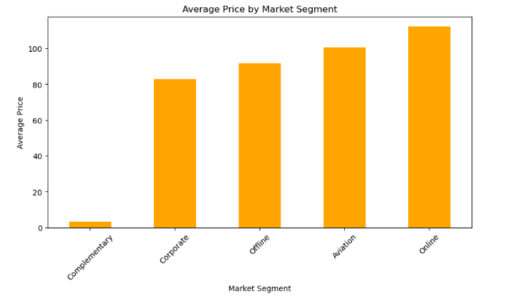
Revenue and Market Segment Insights
Visual: Average Price by Market Segment
Online bookings had the highest average price
Corporate bookings had lower negotiated rates
Premium channels can support revenue growth
Complementary bookings contributed the lowest revenue
Revenue opportunity
Strengthen online booking strategy while carefully managing low-revenue segments.
Hotel Booking Cancellation Prediction
11
Notes:
This chart shows that average price differs across market segments. Online bookings generated the highest average price, suggesting that online customers may be willing to pay more due to convenience, availability, or dynamic pricing. Corporate and offline bookings fall within the mid-range, while complementary bookings contribute very little revenue. This insight suggests that the hotel should continue strengthening its online booking strategy while carefully managing low-revenue segments.

Slide 12
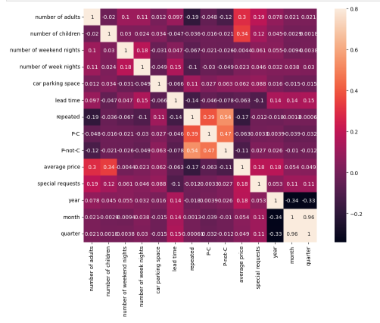
Correlation and Multivariate Insights
Correlation Between Numeric Variables (Heat Map)
Repeat guests were strongly linked with previous successful bookings
Larger groups were associated with higher average prices
Guests with special requests tended to spend more
Lead time remained important for cancellation behavior
These insights highlight customer loyalty, group bookings, and premium service opportunities.
Hotel Booking Cancellation Prediction
12
Notes:
The correlation heatmap showed important relationships between variables. Repeat guests had a strong link with previous successful bookings, which shows the value of customer loyalty. Larger groups and guests with special requests were also linked with higher spending. These findings can help the hotel target valuable customer segments.

Slide 13
Machine Learning Preparation
1
2
3
4
5
Remove irrelevant columns
Encode categorical variables
Scale lead time and average price
Apply SMOTE for class balance
Split data into train and test sets
The final data was prepared for classification modelling
The target classes were balanced before training
The workflow supported fairer model evaluation
Hotel Booking Cancellation Prediction
13
Notes:
For machine learning, columns that were not useful for prediction, such as booking ID and date-based text fields, were removed. The continuous variables, especially lead time and average price, were scaled. Since the booking status classes were imbalanced, SMOTE was used to balance cancelled and not-cancelled bookings before training the models.

Slide 14
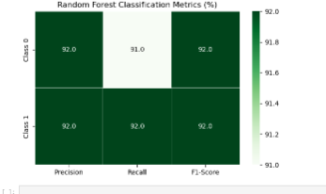
Model Performance
Random Forest Classification Metrics (%)
79%
Logistic Regression accuracy
92%
Random Forest accuracy
Random Forest was selected as the best-performing model because it achieved stronger and more balanced precision, recall, and F1-score.
Hotel Booking Cancellation Prediction
14
Notes:
The Logistic Regression model performed reasonably well, achieving 79 percent accuracy. However, the Random Forest model performed much better, achieving 92 percent accuracy with balanced performance across both cancelled and not-cancelled bookings. After hyperparameter tuning, the Random Forest model maintained strong performance, so it was selected as the best model.

Slide 15
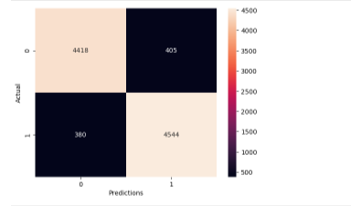
Recommendations and Conclusion
Visual: Confusion Matrix
Apply stricter cancellation policies for long lead-time bookings
Use deposits or non-refundable discounts for early reservations
Send booking reminders to high-risk customers
Strengthen loyalty programs for repeat guests
Target families and larger groups with tailored packages
Use the Random Forest model to flag high-risk bookings early
Conclusion
The Random Forest model achieved 92% accuracy and can support proactive cancellation management, better revenue forecasting, and improved operational planning.
Hotel Booking Cancellation Prediction
15
Notes:
In conclusion, this project showed that machine learning can help the hotel predict booking cancellations and make better business decisions. Lead time was one of the most important cancellation indicators, while customer history, market segment, group size, and pricing also provided useful insights. By using the Random Forest model, the hotel can identify high-risk bookings early and take action to reduce cancellations, protect revenue, and improve planning.

